Slide 1
Temporal crime pattern analysis of Boston
By : Team 5
Notes:
Hello Everyone! We are team 5.
Our topic for today is temporal crime pattern analysis of Boston using historic data.
We’ve tried to analyse different types of crime and its patterns over the period of 2015-2018.

Slide 2

Dataset Overview
Our dataset provides crime incident reports provided by Boston Police Department (BPD) to document the initial details surrounding an incident.
Records begins from 2015 and continue to 2018.
A dataset with more than 2 lakh observations and 17 features.
Each row represents a crime report.
Notes:
Here is a brief overview of out dataset.
We’ve taken the dataset from Kaggle which is sourced from Boston PD.
Records begin from 2015 and continue till 2018.
We have more than 2 lakh observation and 17 features initially.
Each row is a crime report which contains variables like offence description, district code and so on.

Slide 3
Data Preprocessing
Conversion of datatypes to categorical.
01
Typecasted Offence types into Mild and Brutal
02
Replaced district codes with real-time names.
03
Notes:
Coming to the preprocessing part,
First is we’ve converted some of the datatypes to categorical.
Second, we’ve typecasted the offences into mild and brutal. So basically, we had around 67 different types of offences, what we did was, we split that offences into 2 categories. mild and brutal based on the description.
Third, there was a column which had district codes instead of actual district names. So, we replaced them with actual district names from the Boston state.

Slide 4
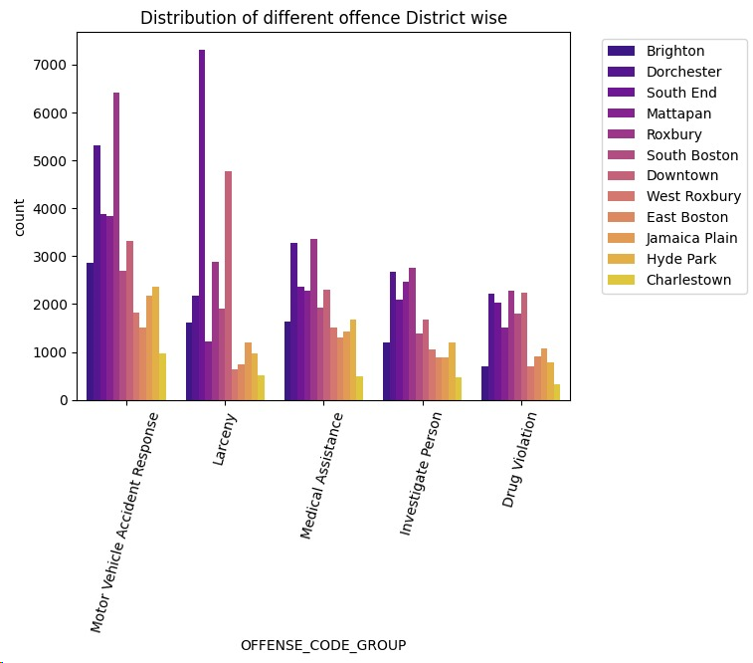
Data Visualization
Offense Distribution
Downtown and South End experiencing the highest incidents of larceny.
Traffic-related offenses are predominantly observed in Brighton and Dorchester, indicating potential hotspots for vehicular incidents.
Drug violations show a marked concentration in Roxbury and Mattapan, suggesting these as focal points for narcotics enforcement.
Notes:
The bar chart illustrates distinct crime patterns across Boston's districts.

Slide 5
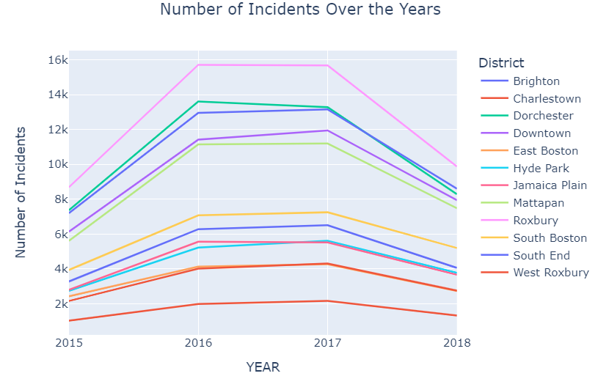
Data Visualization
Incident Distribution over Years
All districts show an increase in incidents from 2015 to 2016 and the trend continues upward into 2017, where most districts peak.
Dorchester, Roxbury, and South End have the highest peaks in 2017, indicating a surge in incidents.
Charlestown remains the district with the lowest number of incidents over the four years.

Slide 6
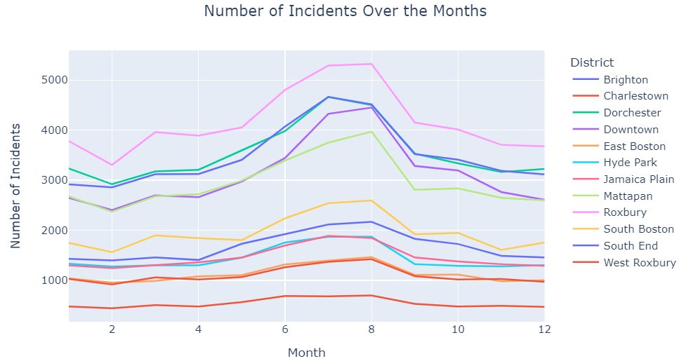
Data Visualization
Incident Distribution over Months
We can see a marked peak around the mid-year.
All districts follow a similar pattern with increased activity in the summer and lower incident rates towards the year's end.
The data suggests seasonality in crime rates, with summer seeing heightened incidents.

Slide 7
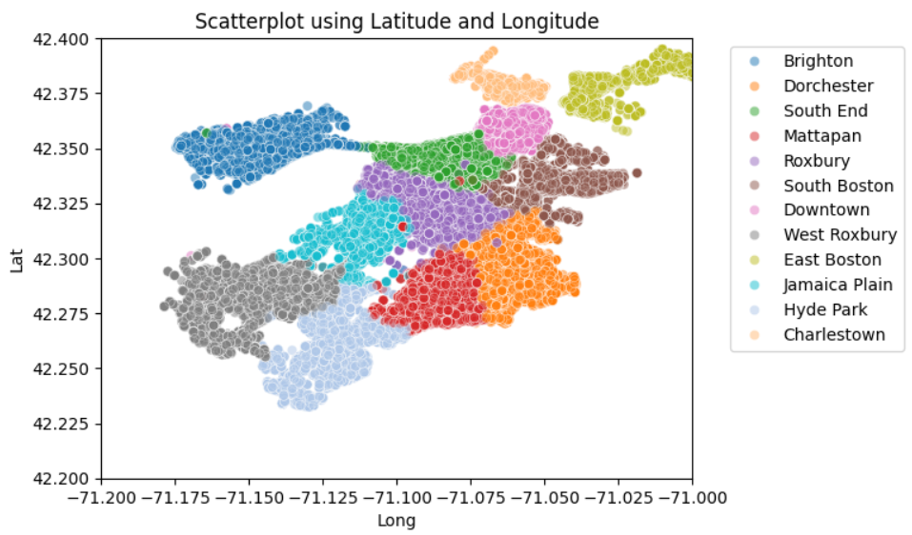
Data Visualization
Geographic Distribution
The scatterplot visualizes the geographic distribution of incidents in Boston by district, using latitude and longitude coordinates.
The densest concentrations suggest areas with higher incident reports, while wider spreads indicate fewer or more dispersed incidents.
This map-like representation helps identify hotspots and the spatial spread of crime across the city.

Slide 8
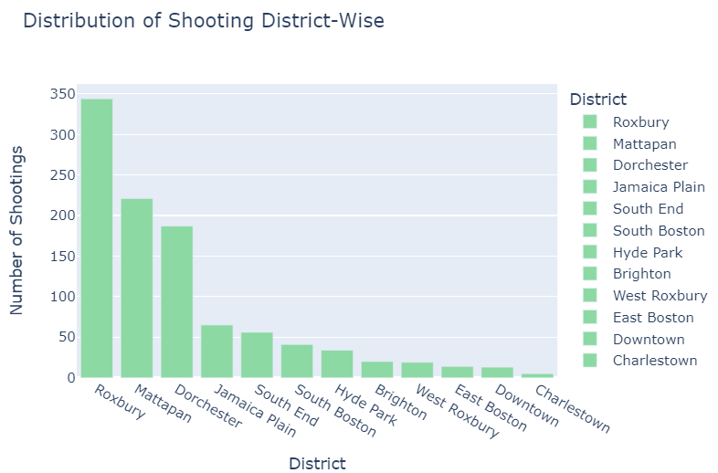
Data Visualization
Shooting Distribution
The bar chart shows Roxbury, Mattapan, and Dorchester as the top three Boston districts with the highest shooting incidents.
These are the concentrated areas of gun violence.
In contrast, Charlestown and other districts report significantly fewer shootings.

Slide 9
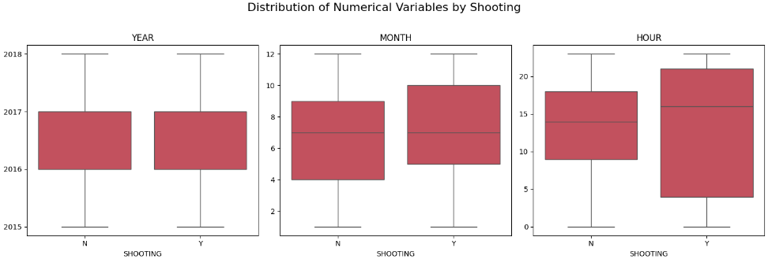
Data Visualization
Patterns of shooting distribution
Across years, shooting incidents occur consistently, without significant variation.
Monthly distributions indicate shootings are slightly more common in the middle of the year.
Hourly, shootings tend to happen later in the day, with a broader spread of times compared to non-shooting incidents.

Slide 10

SMART Questions
Can we identify patterns or trends in nature of crime over the years?

Slide 11
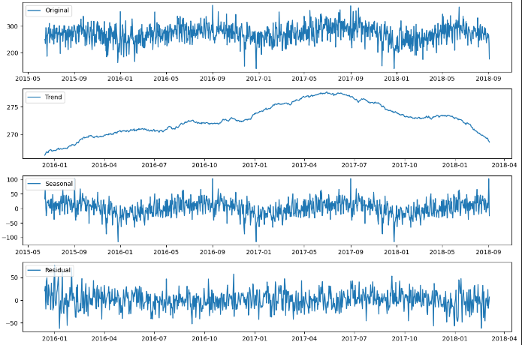
Solution
The analysis shows a clear trend with an average daily crime count of about 273 and a noticeable seasonal variation of around 218 daily crimes.
There's also some unexplained variation (residuals with a standard deviation of 20.06), likely due to factors not considered in the trend and seasonality.

Slide 12
SMART Questions
2. Are there certain locations that have more violent crime or brutal compared to other areas of Boston?

Slide 13
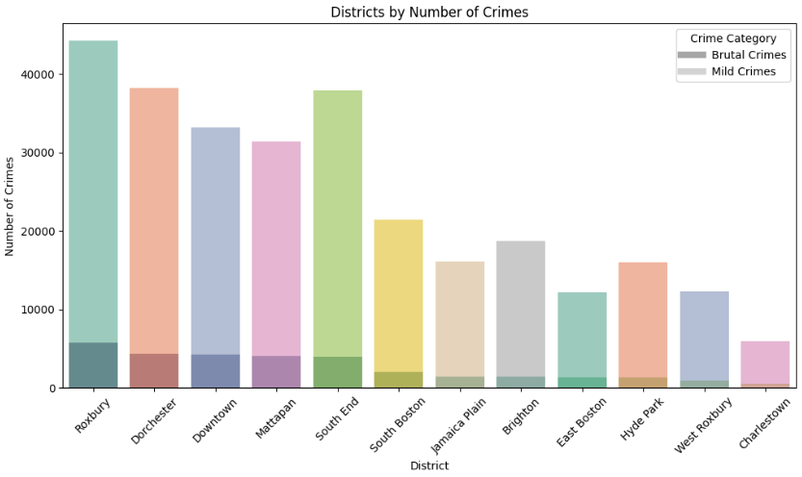
Solution
We categorized the crimes into brutal and mild based in the offence description.
From the plot, we can say that the first 5 districts have higher total numbers of crimes, with significant portions being brutal crimes compared to other areas.

Slide 14
SMART Questions
3. Based on the three years' data, can we forecast the crime rates for the upcoming years in Boston?

Slide 15
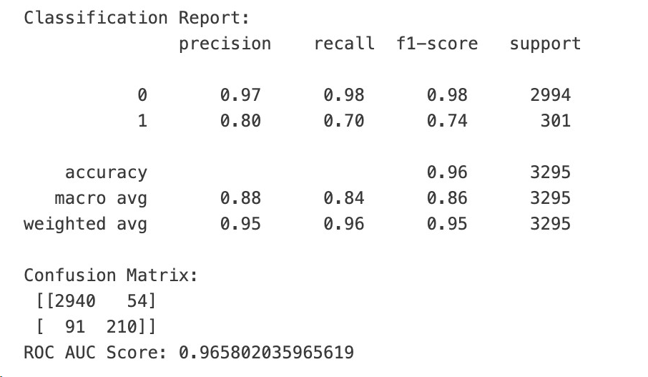
Modeling
Logistic Regression

Slide 16
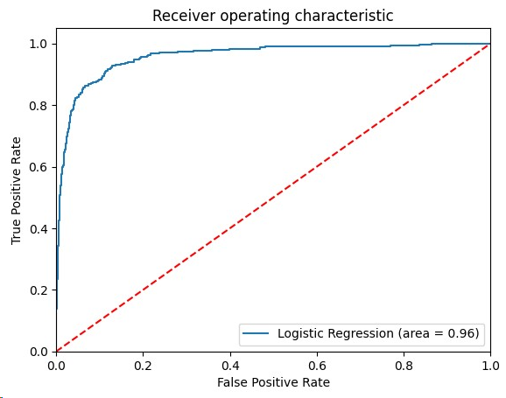
ROC AUC Curve

Slide 17
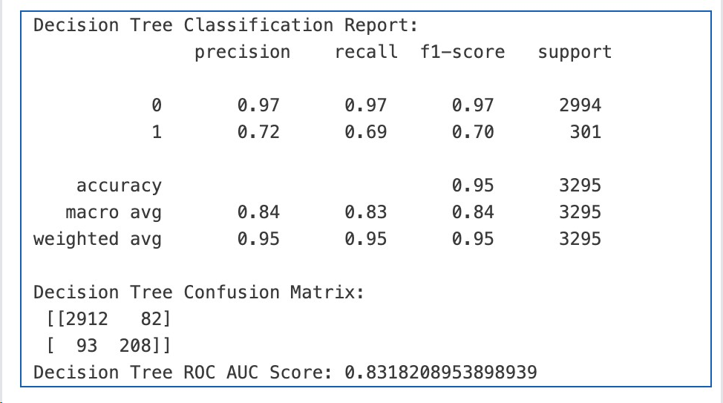
Modeling
Decision Tree

Slide 18
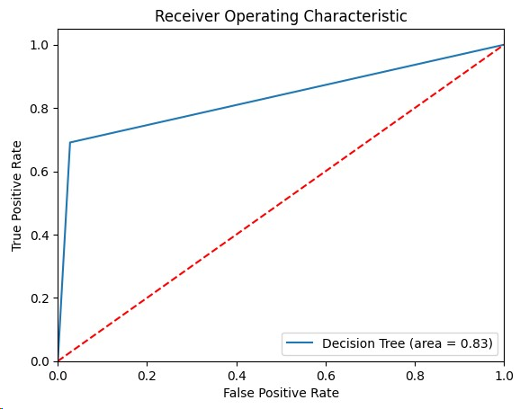
ROC AUC Curve

Slide 19
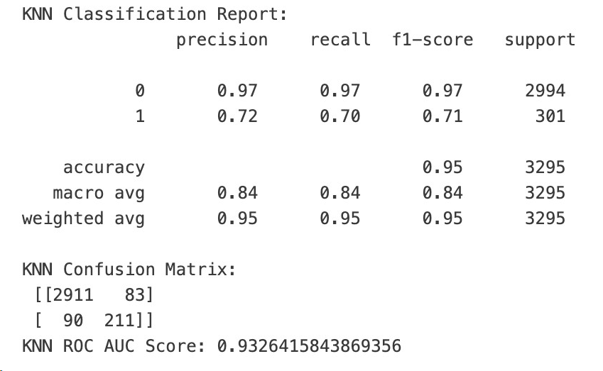
Modeling
KNN Classification

Slide 20
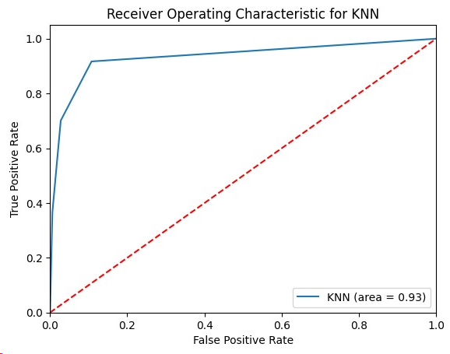
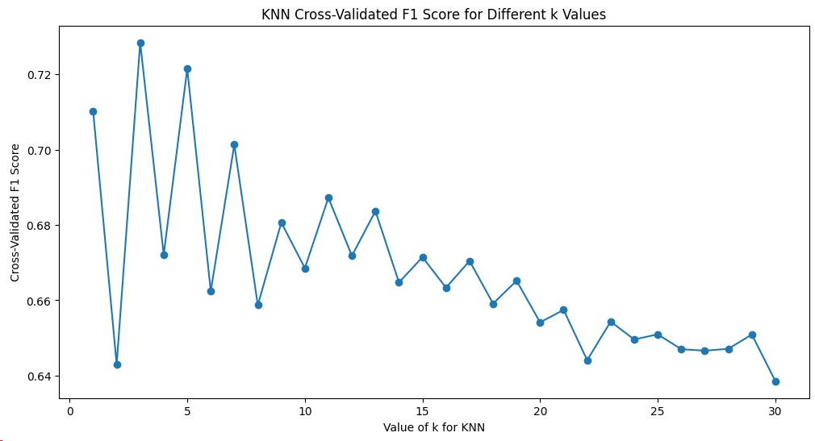

Slide 21
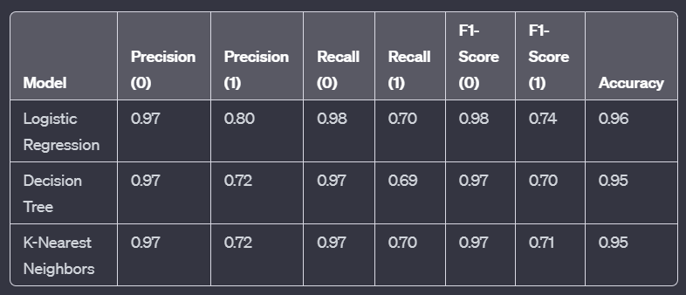
Model Comparision

Slide 22
THANK YOU

